Slide 1
Honey Bunches of A**
You laughed, admit it ☺

Slide 2
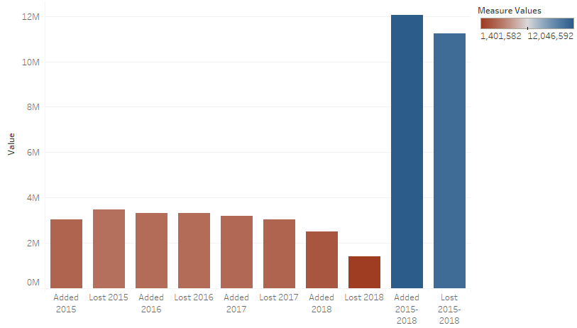
Colonies Added/Lost, 2015-2018

Slide 3
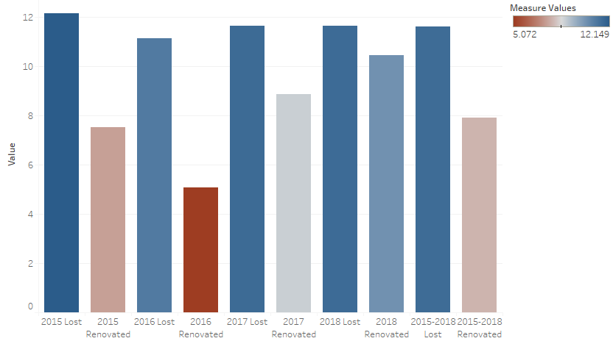
Percentage Lost/Renovated, 2015-2018

Slide 4
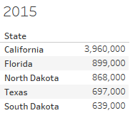
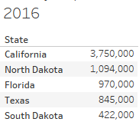
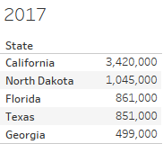
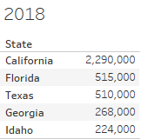
Top Five States Per Colony By Year

Slide 5
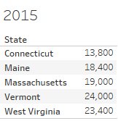
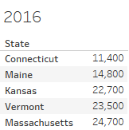
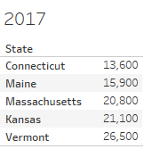
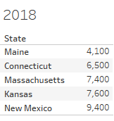
Bottom Five States Per Colony By Year

Slide 6
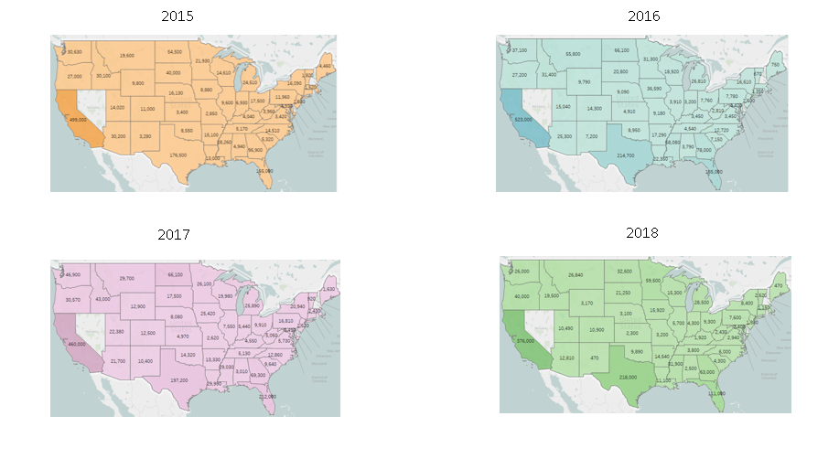
Colonies Added Per State, 2015-2018

Slide 7
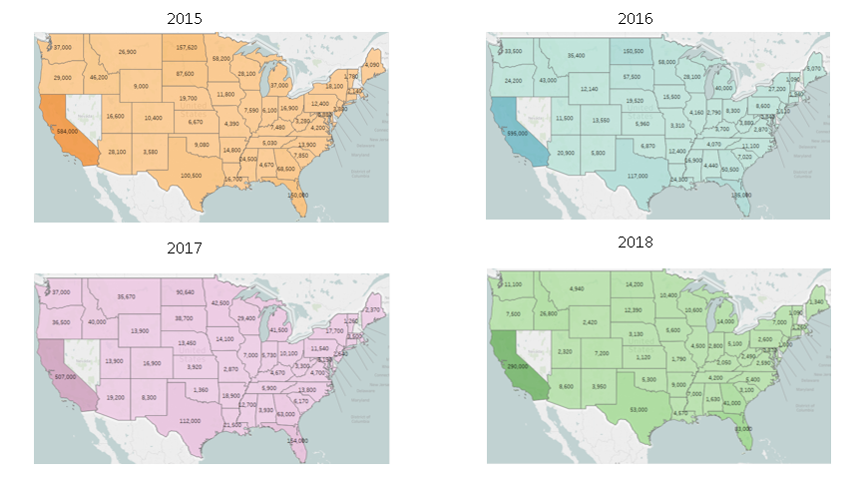
Colonies Lost Per State, 2015-2018

Slide 8
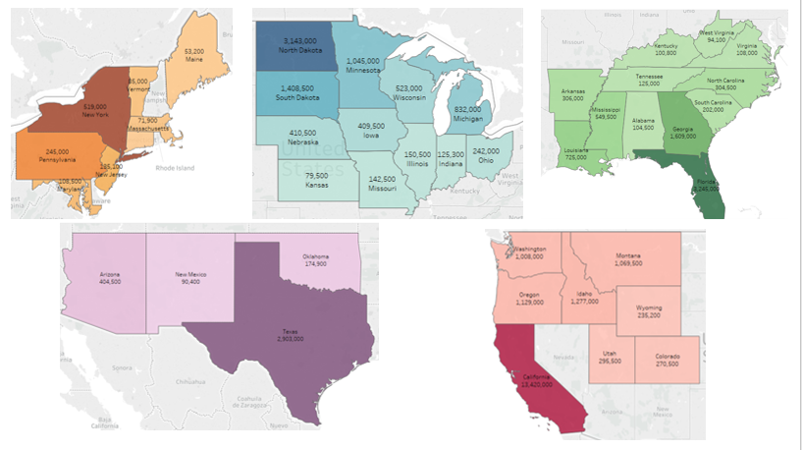
Total Colonies Per Region, 2015-2018

Slide 9
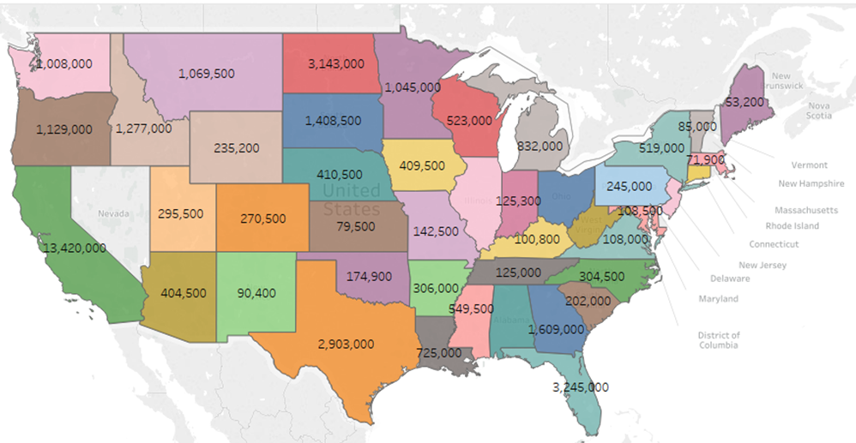
Total Colonies Per State, 2015-2018

Slide 10
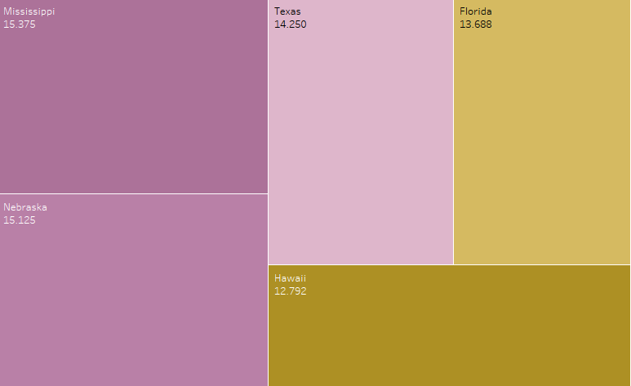
Top Five States Per Percent Renovated, 2015-2018

Slide 11
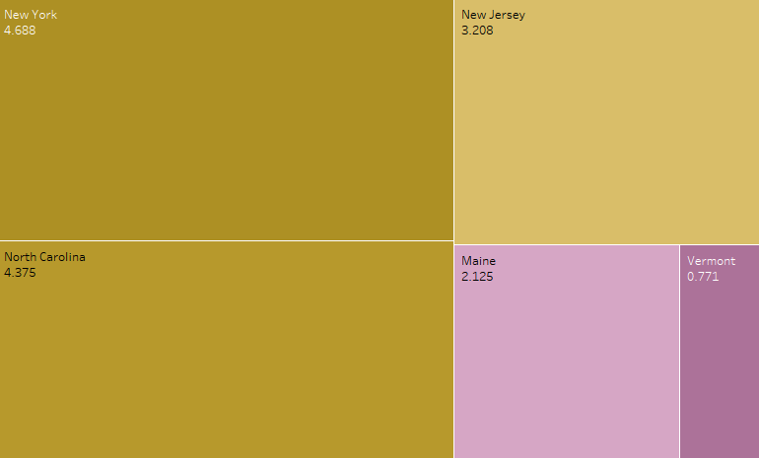
Bottom Five States Per Percent Renovated, 2015-2018

